Slide 1
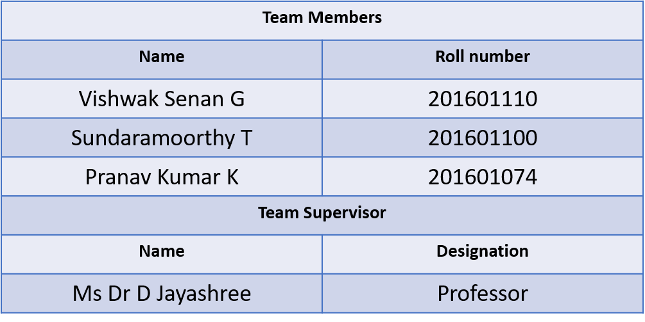
Essay Grading Using Ensemble Strategies and Word2Vector Method

Slide 2
Abstract
The project gives linguistic support to the users who wants check the authenticity of an English essay. The project’s primary service is hosted in cloud architecture and use API keys to access it securely. This also provides an attractive dashboard to the users to keep track of their scores and their essays. The primary service includes evaluation of
1. Grammar and Spell Check.
2. Sentence Complexity.
3. Style Continuity.
4. Advanced lexical resources.
5. Cohesion and Coherence.

Slide 3
Existing System
Grammarly: Grammarly is an famous software used to word correction and suggestion in the sentence. This product is not capable to do the same for a whole paragraph and for long essays.
ProWritingAid: ProWritingAid provides the users to fix their writing style and eliminate errors by providing a browser extension.
WhiteSmoke: WhiteSmoke is also very efficient English writing and proofreading tool. It indicates the grammar as well as punctuation, spell checking, and writing style suggestions.
Ginger: Ginger is another quite brilliant tool among students, teachers, and bloggers due to its efficient outcomes. The Ginger proofreading tool while typing in the editing boxes such as WordPress or simply go to their site and paste the text.

Slide 4
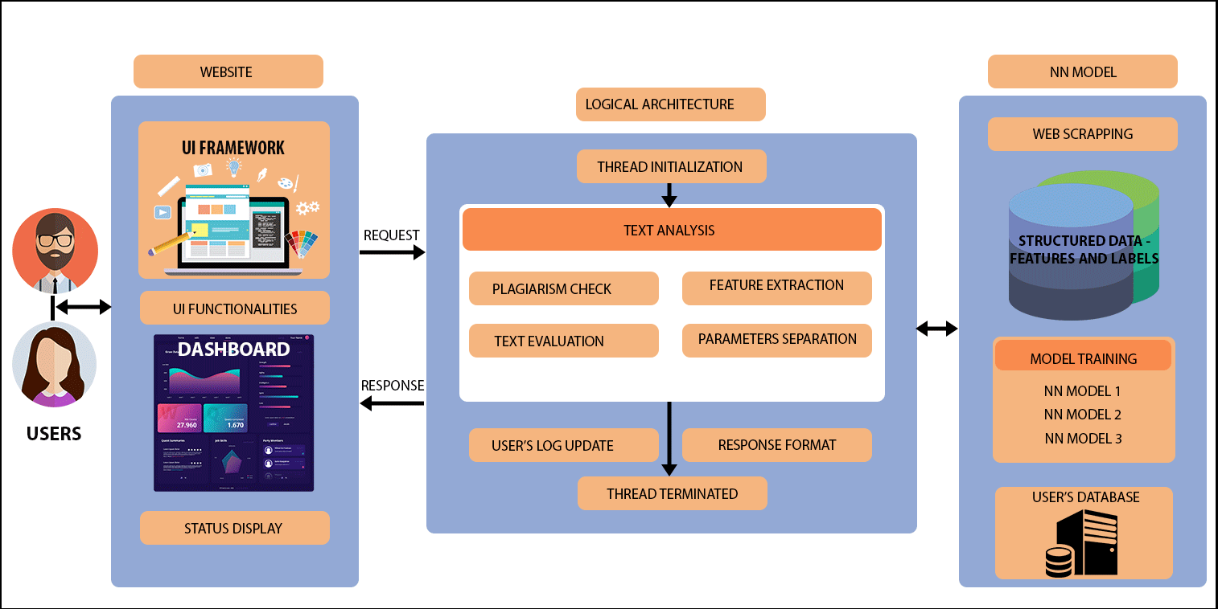
System Architecture

Slide 5
Literature Survey
Paper Title | DOI Number | Inference
Text Classification using Different Feature Extraction Approach | 10.1109/eStream.2019.8732167 | The TF-IDF weighing scheme works by weighing a keyword in any context and assigning the importance to that keyword based on number of times it appears on the document. One of the main drawbacks is the size of the feature set in TF-IDF for text data which equals to the size of the vocabulary across the entire corpus, thus resulting in huge computation on weighing all the words in the data set.
Analysis of Text Categorization Represented with Word Embeddings Using Homogeneous Classifiers | 10.1109/INISTA.2019.8778329 | Word2vec representation learning method with ensemble systems to increase the text classification accuracies. Word embeddings are obtained from the training data through word2vec tool by using shallow neural networks. Two variants of naive Bayes (NB) namely, multivariate Bernoulli NB (MVNB), and multinomial NB (MNB), support vector machine (SVM), and decision tree (DT) are used as single classifiers.

Slide 6
A Fuzzy Approach to Text Classification with Two-Stage Training for Ambiguous Instances | 10.1109/TCSS.2019.2892037 | Traditional fuzzy approaches generally employ a fixed rule (based on maximum membership degree) to provide a distinct class label as an output. Bag of Words (BOW) extracts a bag of distinct words for textual data, and each of the words is used as a feature.
Noisy text categorization | 10.1109/ICMLA.2006.52 | Several categorization approaches have achieved state-of-the-art performance. In this work, we apply support vector machines because there is theoretical evidence that they are especially suitable for data with characteristics typical of document vectors: very high dimensionality (several thousand dimensions), sparseness (few features have values different from zero), high number of relevant features (every term is important even if it appears only a few times), distribution of the term frequencies following Zipf’s Law, and a high level of redundancy (several features account for the same category).

Slide 7
Exploring Feature Selection and Support Vector Machine in Text Categorization | 10.1109/CSE.2013.160 | Text categorization (TC) is a task of automatically assigning a document into a set of predefined categories. This paper explores several methods of feature selection that can be used to reduce high dimensionality of feature space in text documents such as Information Gain, Gain Ratio, Chi-Squares, Mutual Information and Document frequency.
Graph-Based Semantic Learning, Representation and Growth from Text: A Systematic Review | 10.1109/ICOSC.2019.8665592 | Graph-based text representation, in the form of text graphs, is an alternative approach to the Vector-Space Model (VSM), also known as Bag-Of-words (BOW). Text Rank presents a graph-based ranking model, relying on an algorithm derived from Googles PageRank algorithm. Text Rank does not require deep linguistic knowledge. The Text Rank model does not include the cognition and psycholinguistic-based factors which is the main limitation of this technique.

Slide 8
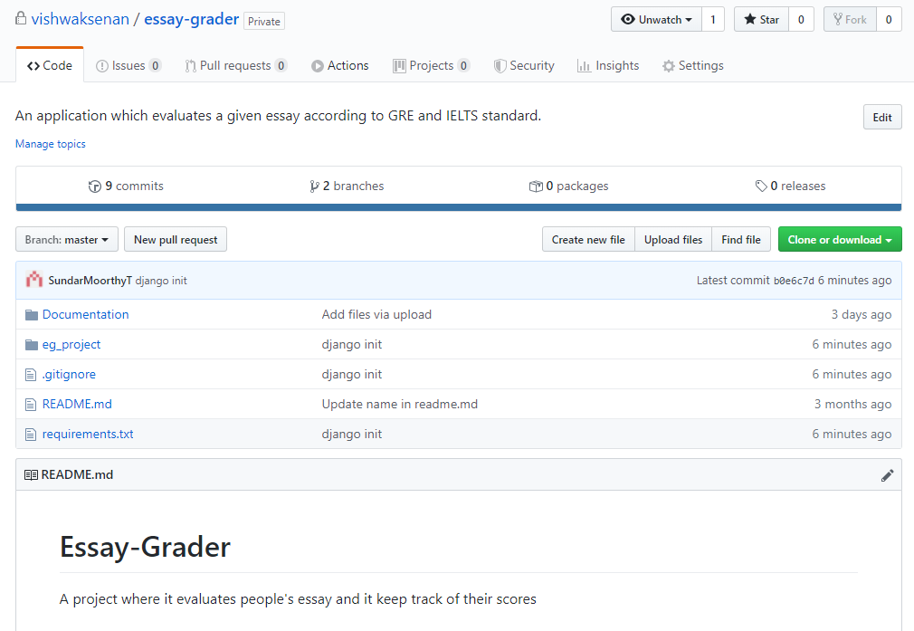
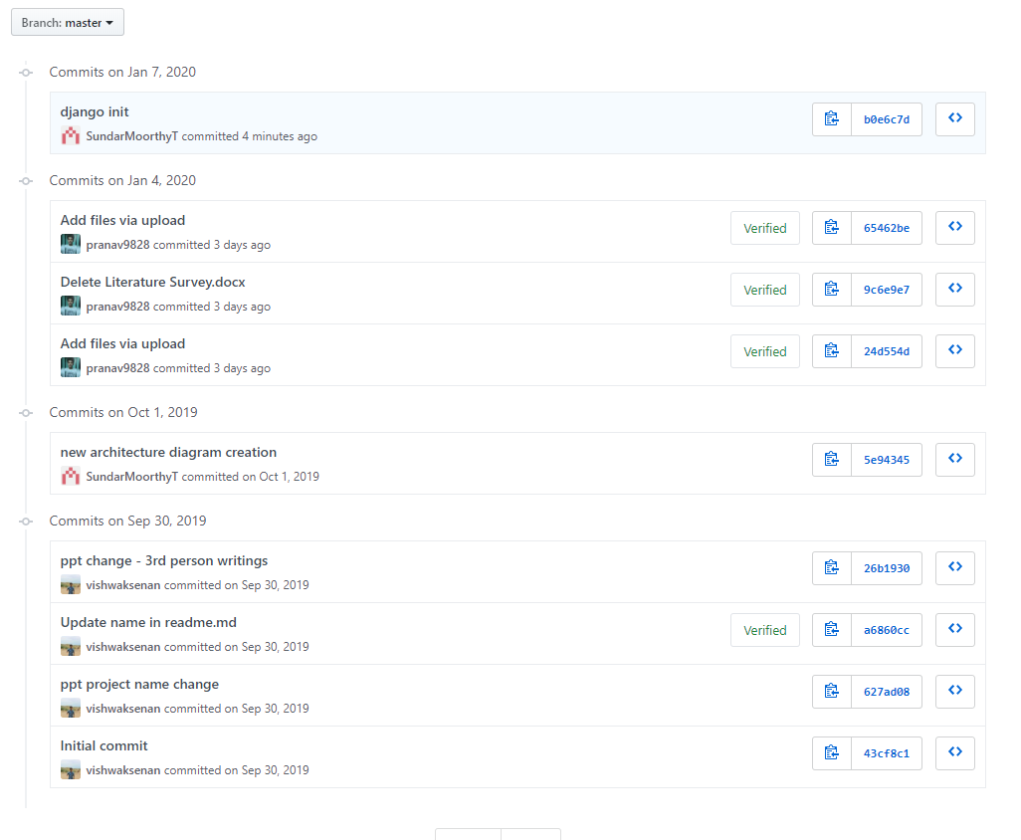
Progress Report

Slide 9
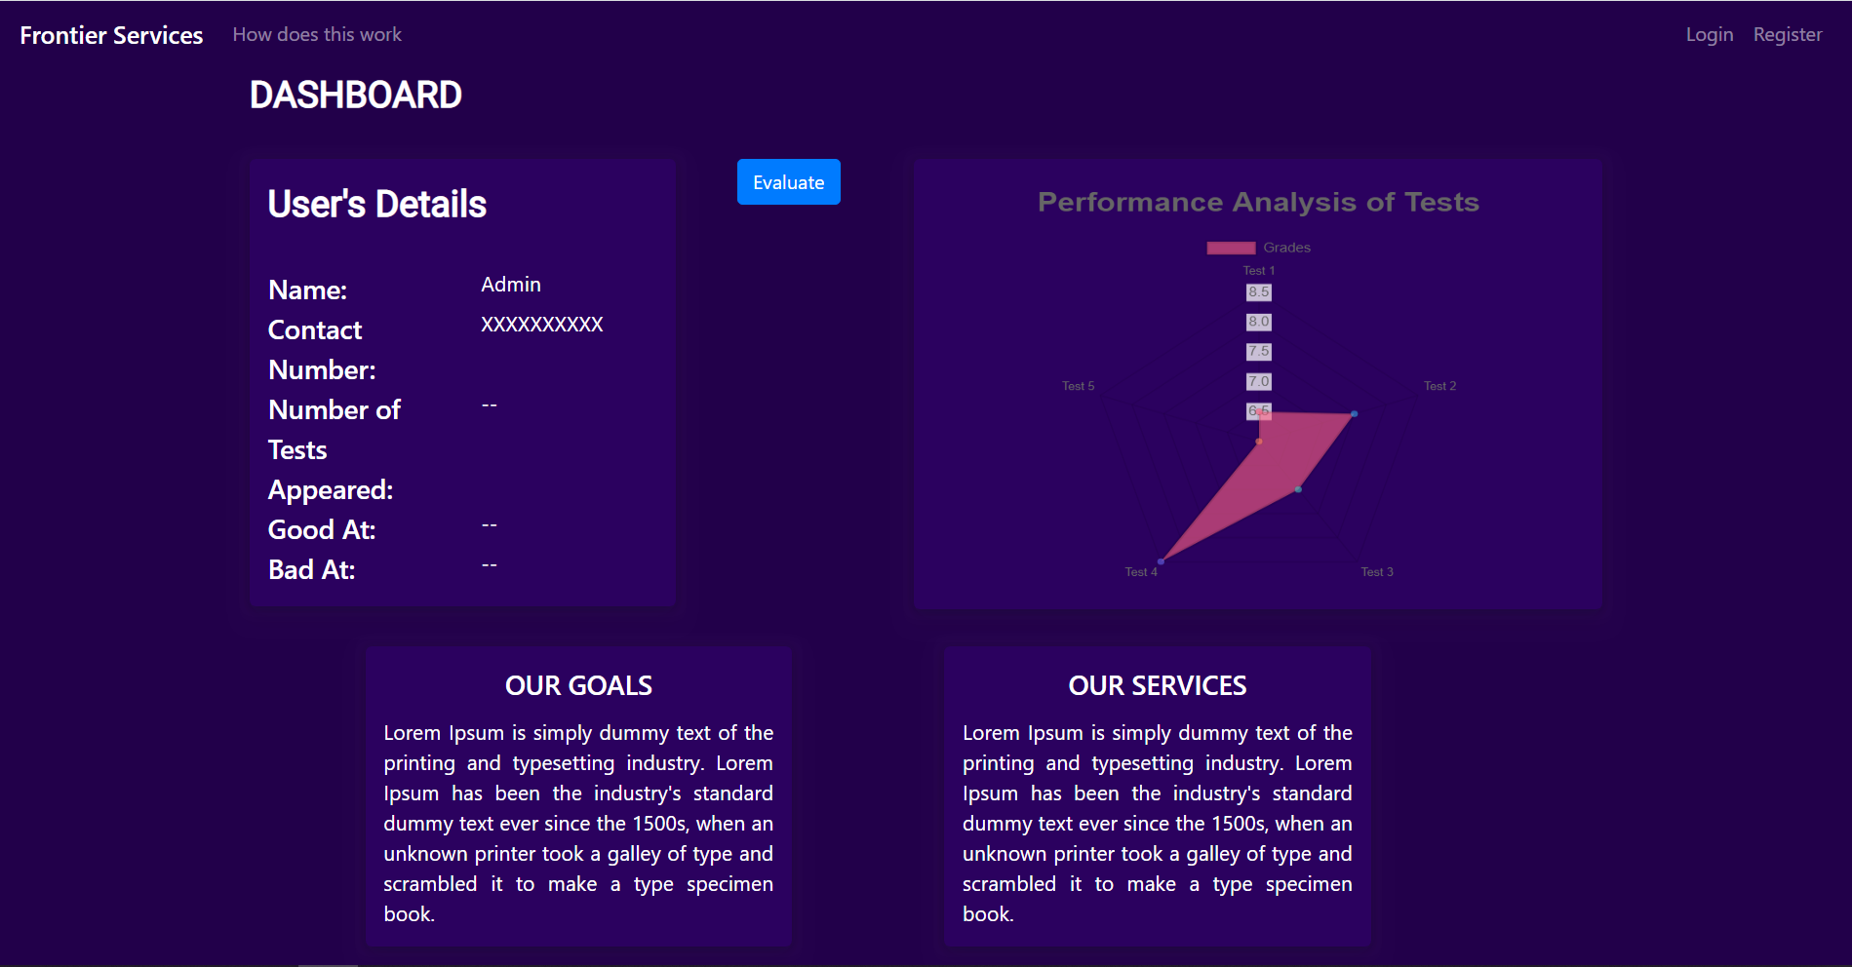
Output Screenshots

Slide 10
